Slide 1

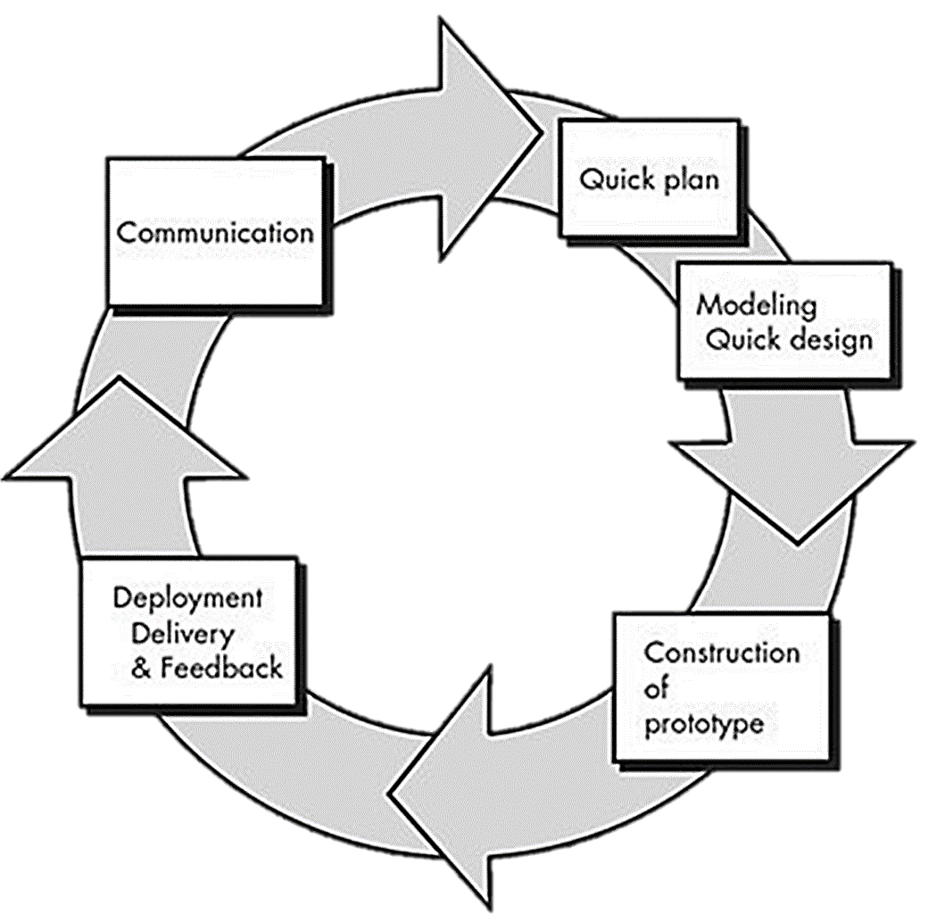
PROTOTYPE MODEL
Team 1
Ricardo Alejandro Palma Rivas
Russel Adrián Bonilla Pech
José Luis Lara Rubio
Juan Emmanuel Escamilla Poot
Monserrat Anaya Alva
Diego Hernández Marín

Slide 2
PROTOTYPE MODEL
Recompilation and specification of the requirements
COMUNICATION
QUICK PLANING
The prototype is presented to the interested parties, who review it and give feedback
DEPLOYMENT / FEEDBACK
Prototype planning
This model is useful when the client doesn’t know all the requirements at the beginning of the project, for example, when there doesn’t exist a similar product.
The cycle is repeated until the project is finished
QUICK DESIGN
Design of the prototype
(Example: User interface)
The prototype is developed
CONSTRUCTION OF THE PROTOTYPE

Slide 3

EXAMPLE
Prototype methodology is widely used in videogame development, in this case we will use the development of "The legend of Zelda: breath of the wild“.

Slide 4
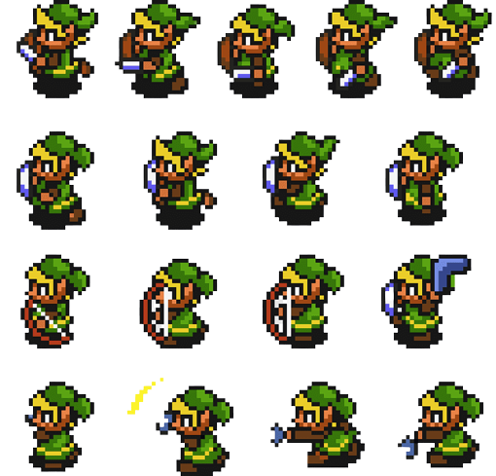
First cycle
During this first cicle, the developers stablished the general idea for the game and built an extremely basic prototype to showcase the general mechanics and interactions of the game.

Slide 5
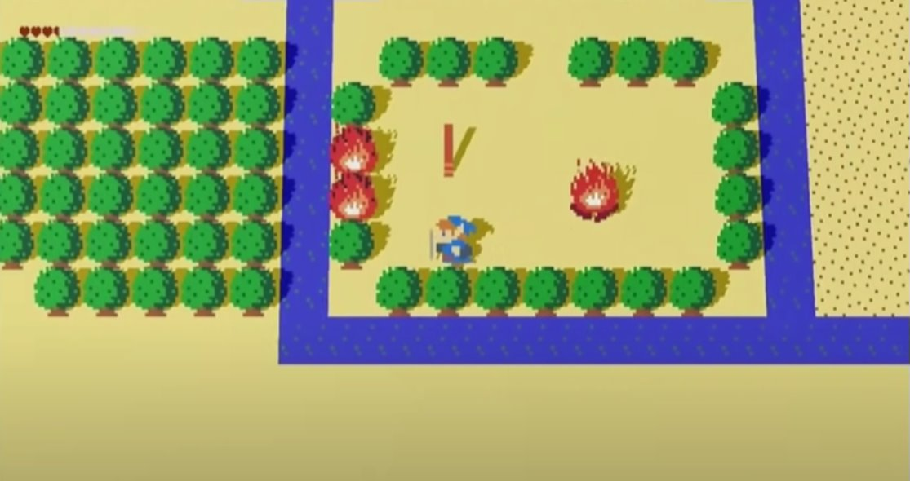

Slide 6

Second cycle
In the second cycle the idea was expanded upon, and the art style was decided.
For the prototype, they developed a 3D version of the previous one using mostly placeholder art and adding some new interactions that made use of the physics engine.

Slide 7
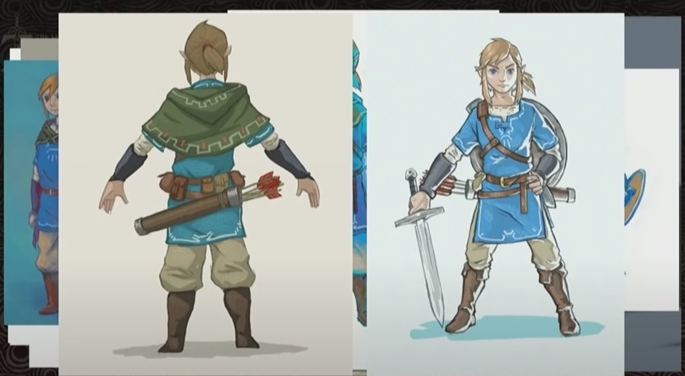

Slide 8
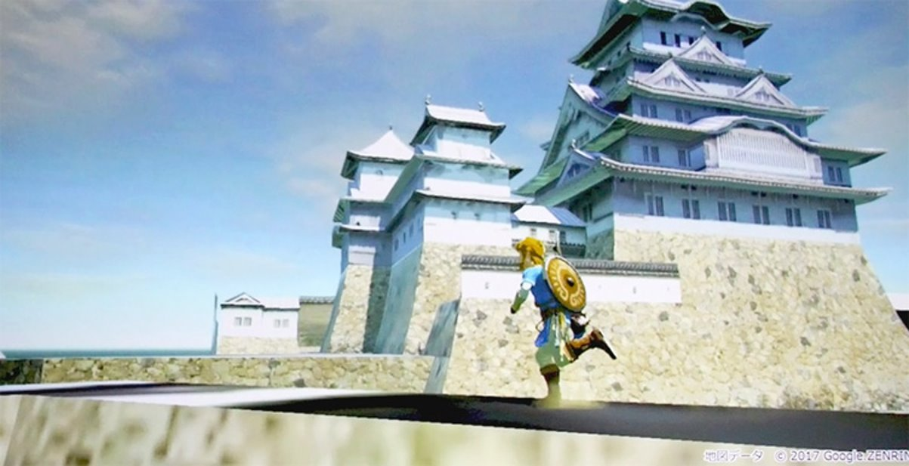

Slide 9
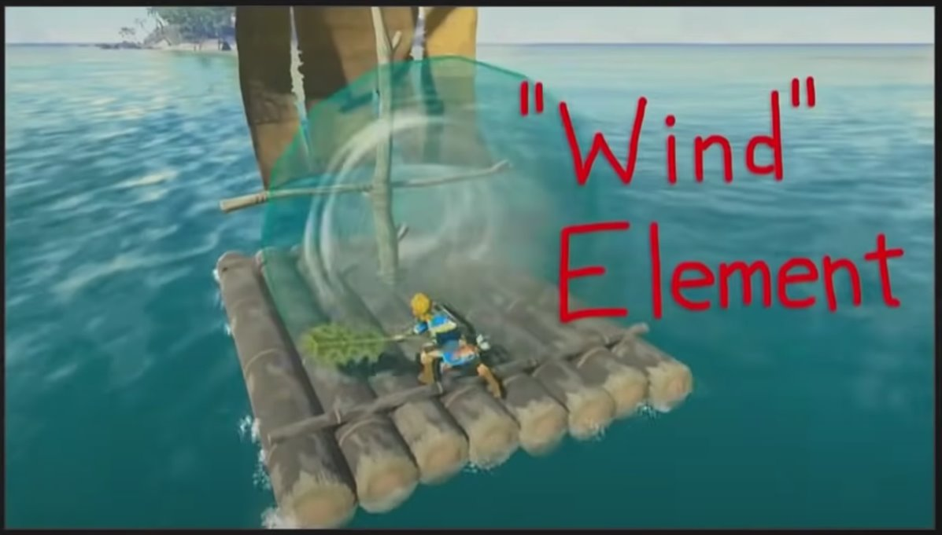

Slide 10
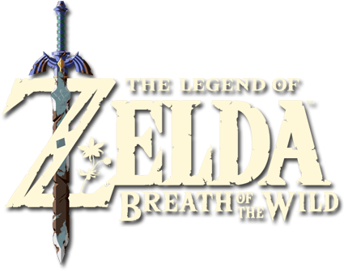
Third cycle
Now that they had a playable base, the third cycle was used to develop the first “complete” prototype, included some of the history elements, the first version of the UI and mostly finalized assets.
This prototype was given to game testers with the objective of collecting feedback end finding game-breaking bugs.

Slide 11
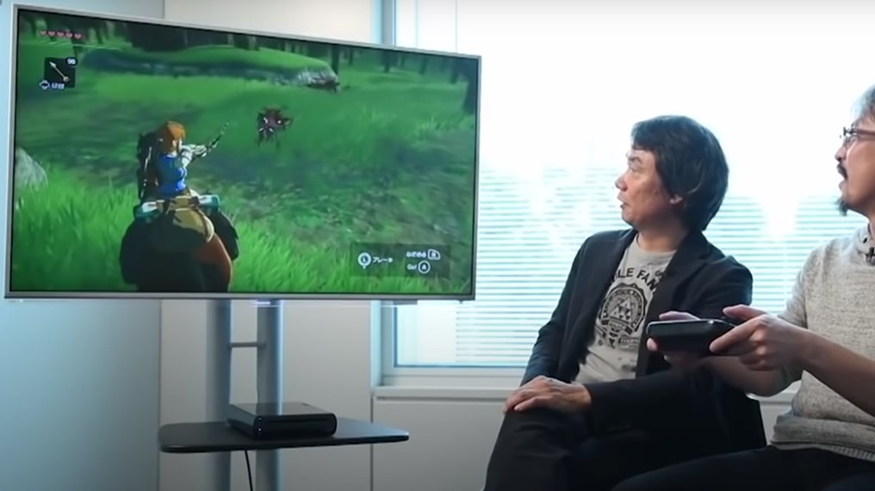

Slide 12
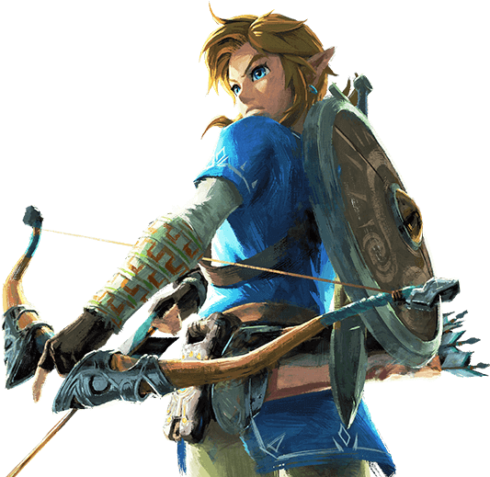
Fourth cycle
Finally, the fourth cycle was used to build the finalized version of the game, they mostly made minor improvements based on the Feedback received, fixed bugs and completed the story.

Slide 13
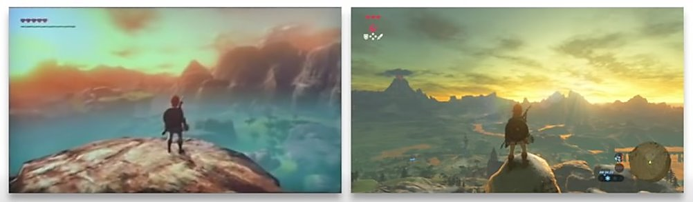
Prototype
Final

Slide 14
DIFFERENCES WITH SCRUM
DEVELOPMENT
FINAL PRODUCT

Slide 15
DIFFERENCES WITH SCRUM
DEVELOPMENT
FINAL PRODUCT

